Slide 1

Design Guide
Building Beautiful PowerPoint Presentations with Manus AI
A visual walkthrough of design principles, technical implementation, and workflow mastery
Notes:
We're here to talk about how to stop building presentations one slide at a time and start designing them as a cohesive, beautiful whole. The goal isn't just to make slides look nice; it's to use design principles to make your message clearer, more memorable, and more professional. Think of this as a design guide for the modern presenter, moving beyond default templates and into intentional visual communication. We'll cover the foundational rules, the design philosophies that inform your choices, and the technical implementation details that ensure consistency. By the end of this session, you'll have a framework for creating presentations that truly stand out, whether you're presenting to a board or teaching a class. It’s about mastering the workflow so the design supports your content, not distracts from it. Let's start with the most important rule for efficiency.

Slide 2
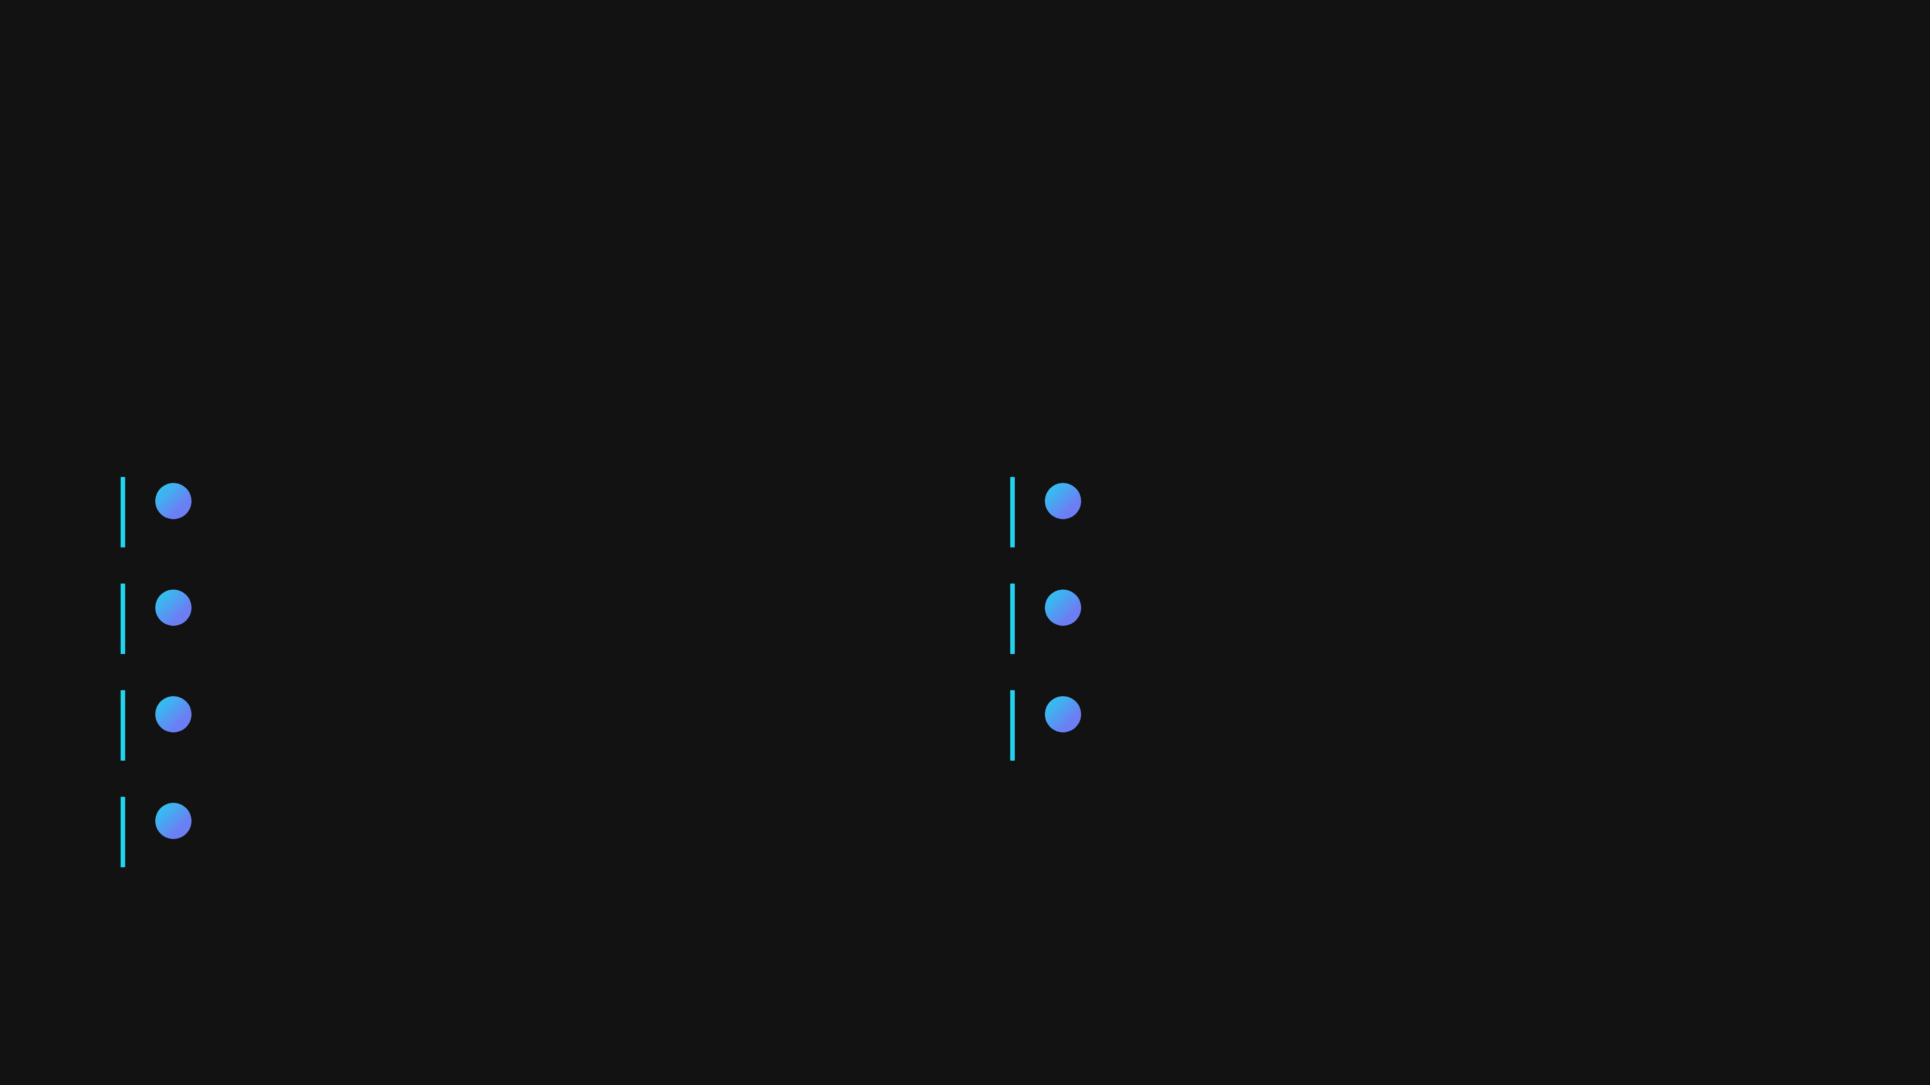
Foundational Principle
The 30-70 Planning vs Execution Rule
30%
70%
Planning
Execution
Design Philosophy
Building
Choose movement, establish palette, select typography
Batch similar slides, copy-paste CSS, only change content
Content Outline
Consistency
Map all slides, plan layout variety, identify visuals
Maintain styles, use reference slide as template
Visual Variety
Optimisation
Ensure no two consecutive slides use identical layouts
Check contrast, verify alignment, test typography
Constraints
Define what to include and exclude upfront
Notes:
The 30-70 rule is the single most important principle for efficient presentation design. It dictates that you should spend 30% of your time on planning and 70% on execution. Most people flip this, tinkering with slides as they go, which leads to inconsistency and wasted time. The planning phase is where you make all the big decisions: choosing your design movement, establishing the colour palette, and mapping out the entire content flow. This upfront work prevents rework later. Once you move into the 70% execution phase, you are simply building, not deciding. You batch similar slides, copy-paste styles, and focus purely on content insertion and consistency checks. This disciplined approach ensures that your final presentation is cohesive and that you don't waste hours fiddling with individual slide layouts. Now that we understand the importance of planning, let's look at the design philosophies that inform your initial choices.

Slide 3
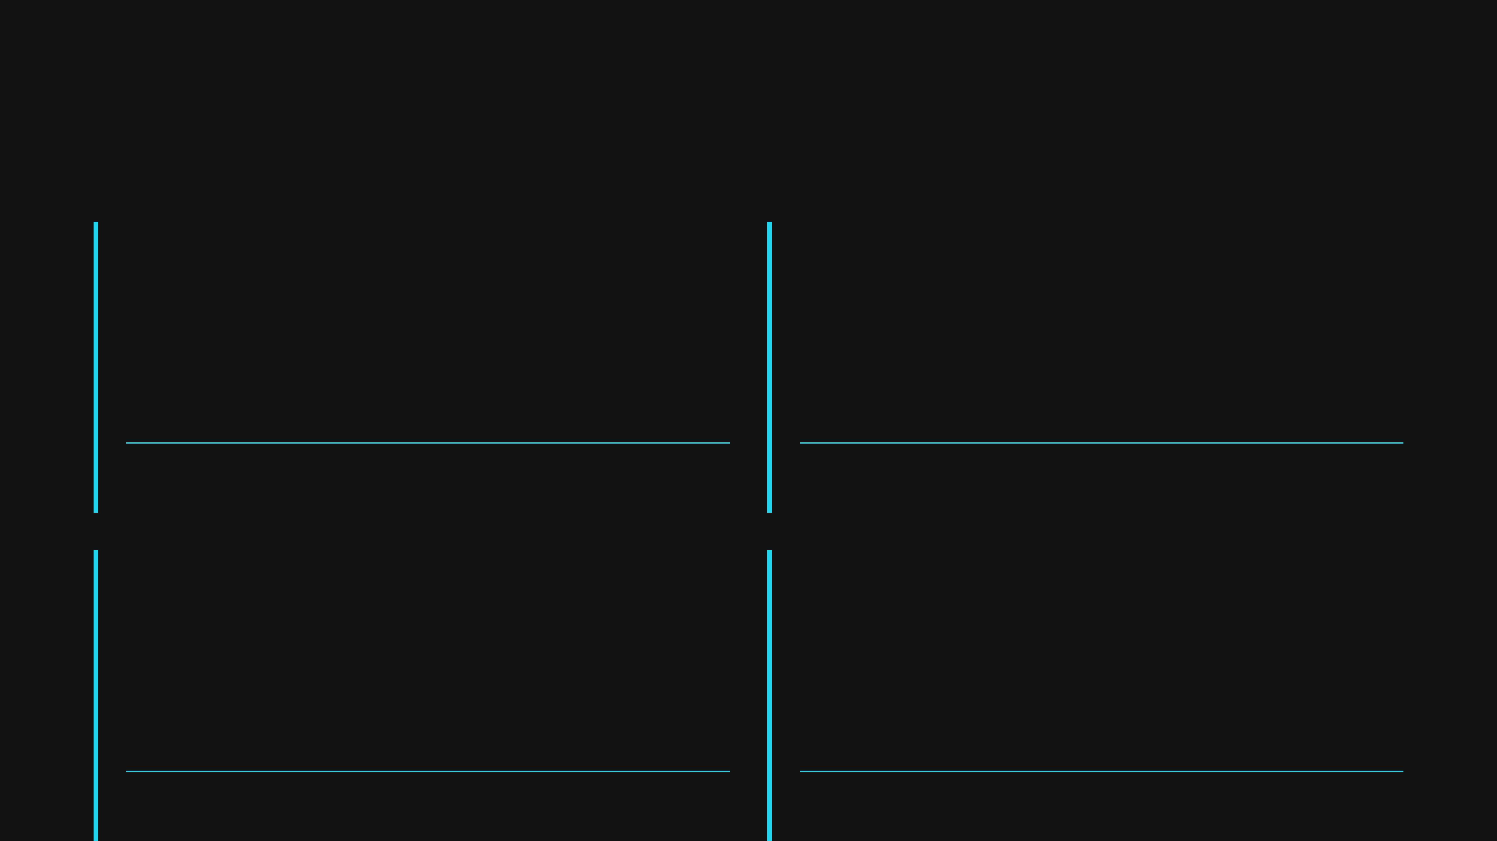
Design Philosophy
Four Design Movements for Presentations
Swiss International
Brutalist Minimalism
Grid-based layout
Stark, raw aesthetic
Minimal ornamentation
Extreme contrast
Cyan accents
Unconventional typography
High contrast
Memorable impact
Best Use
Best Use
Technical presentations, CTOs, enterprise
Conceptual presentations, creative pitches
Bauhaus Modernism
Neoclassical Elegance
Geometric shapes
Symmetrical layout
Bold primary colours
Serif typography
Functional beauty
Gold accents
Dynamic composition
Refined spacing
Best Use
Best Use
Creative presentations, product launches
Formal presentations, luxury brands
Notes:
Choosing a design movement is part of that crucial 30% planning phase; it sets the entire tone and visual language for your presentation. We've identified four distinct movements that offer a strong starting point. For instance, Swiss International is perfect for technical or corporate audiences, relying on grid-based layouts and high contrast for clarity and professionalism. In contrast, Brutalist Minimalism uses stark aesthetics and unconventional typography to create a memorable, high-impact presentation, often suited for creative pitches. Bauhaus Modernism brings in geometric shapes and bold primary colours for a dynamic, functional feel, great for product launches. Finally, Neoclassical Elegance uses symmetry and refined spacing with serif fonts, ideal for formal or luxury brand presentations. Selecting one of these movements upfront gives you a consistent set of constraints to work within, ensuring visual harmony across all your slides. A key element of any design movement is how it handles text, which brings us to typography.

Slide 4
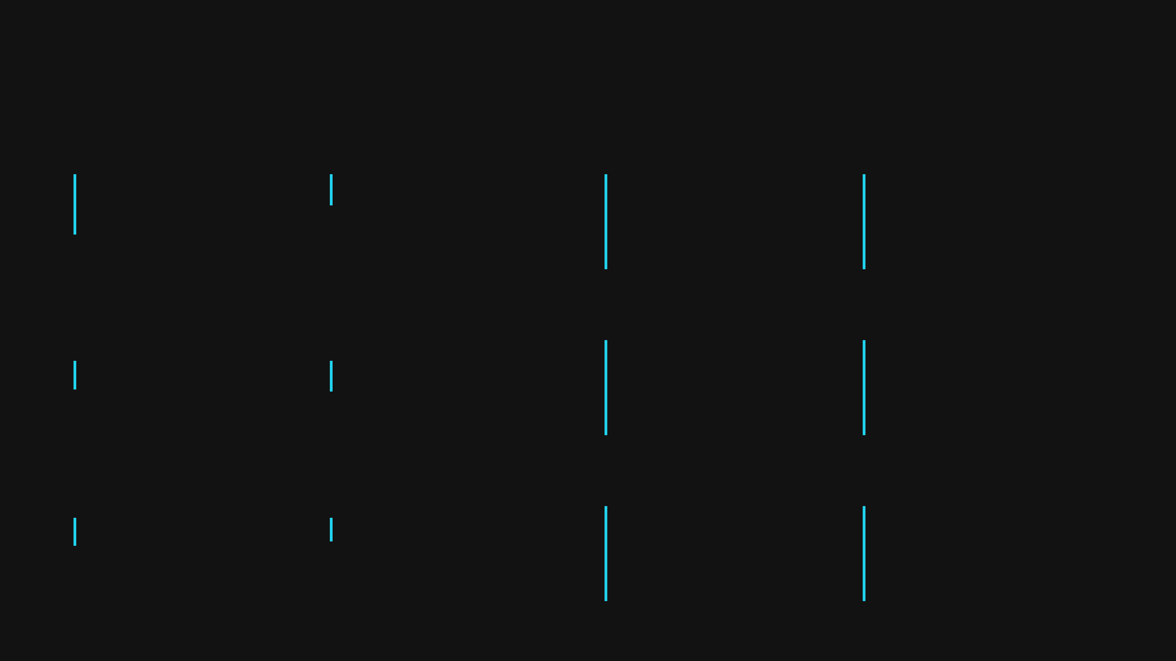
Visual Hierarchy
Typography Hierarchy System
Slide Title
Section Title
Slide Title
Section Title
48px • Bold (700)
20px • Semi-bold (600)
Line height: 1.2
Line height: 1.3
Letter spacing: -0.5px
Letter spacing: 0px
Item Title
Body Text
Item Title
Body Text
18px • Semi-bold (600)
16px • Regular (400)
Line height: 1.3
Line height: 1.6
Letter spacing: 0px
Letter spacing: 0px
Description
Labels
Description
Labels
15px • Light (300)
13px • Semi-bold (600)
Line height: 1.5
Line height: 1.0
Letter spacing: 0px
Letter spacing: 1px
Notes:
Typography is the silent workhorse of your presentation; a clear hierarchy ensures your audience knows exactly where to look and what information is most important. This system defines six distinct text styles, from the large, impactful Slide Title down to the small, functional Labels. Notice the precise specifications for each level: we're defining not just the font size, but also the weight, line height, and even letter spacing. For example, the Slide Title uses a bold weight and a tight line height for maximum impact, while the Body Text uses a regular weight and a generous line height of 1.6 for readability. Establishing this system in your 30% planning phase means you never have to guess how to format text during the 70% execution phase. Consistency in these details is what separates a professional presentation from an amateur one. Just as important as text is the strategic use of colour.

Slide 5
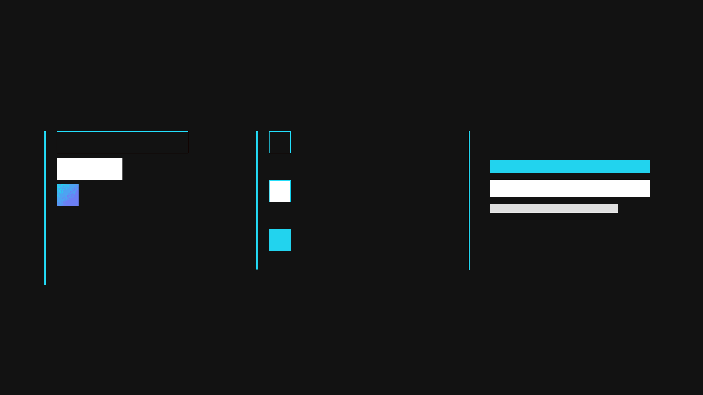
Colour Theory
The 60-30-10 Colour Rule
Proportional Distribution
Colour Palette
Application Example
60%
Primary
#121212
oklch(0.141 0.005 285.823)
30%
Contrast: 21:1
Secondary
10%
#FFFFFF
oklch(0.85 0.005 65)
Contrast: 1:1
Accent
#22D3EE
oklch(0.6 0.2 200)
60% primary background, 30% secondary text, 10% accent emphasis
Contrast: 8:1
Notes:
The 60-30-10 rule is a classic interior design principle that translates perfectly to presentation design, ensuring a balanced and professional colour palette. This rule dictates the proportional distribution of your three chosen colours: 60% for the dominant primary colour, 30% for the secondary colour, and 10% for the accent colour. The primary colour typically covers large areas like the background, setting the overall mood. The secondary colour is used for supporting elements, most often text and secondary graphics. Crucially, the accent colour is reserved only for emphasis—think key data points, calls to action, or important headings. Look at the example: the dark primary colour dominates, the white secondary colour provides excellent contrast for readability, and the bright cyan accent draws the eye precisely where you want it. This disciplined approach prevents your presentation from looking cluttered or overwhelming. Now that we've covered the foundational rules of planning, colour, and typography, let's look at how to structure the slides themselves.

Slide 6
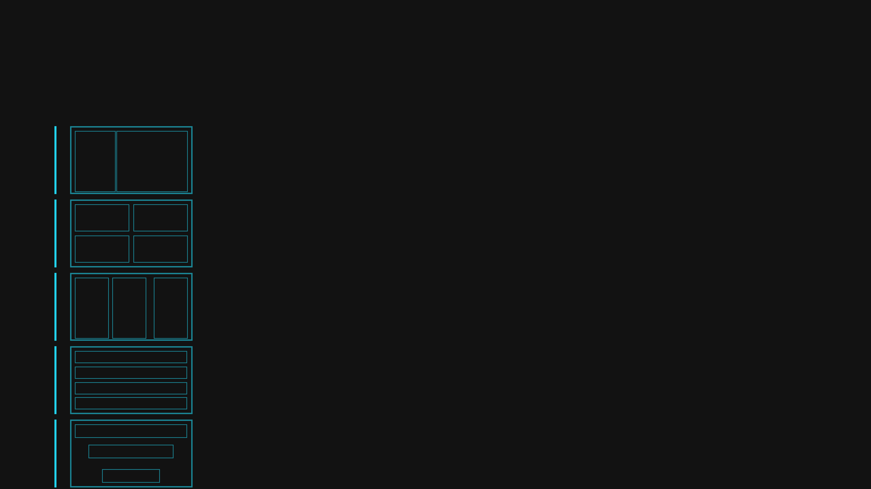
Layout Variety
Five Proven Layout Patterns
Asymmetric Split
1fr 2fr grid for hero impact and visual interest
Hero slides, problem/solution pairs, keyblades & devetts
2x2 Grid
Four equal quadrants for related concepts
Four concepts, challenges, benefits, features
3-Column Grid
Three parallel concepts with equal emphasis
Assembly lines, pillars, process stages, benefits
Vertical List
Sequential items with consistent spacing
Steps, agenda items, detailed breakdowns, timelines
Funnel
Decreasing width to show narrowing/filtering
Process flows, results, conclusions, prioritisation
Notes:
We've covered colour, but how do we structure the content on the slide itself? Layout is the skeleton of your design, and you don't need to reinvent the wheel every time. We've identified five proven layout patterns that cover 90% of your presentation needs. The Asymmetric Split, for example, uses a 1fr 2fr grid to create immediate visual impact, perfect for a hero slide or a clear problem-solution pairing. Then you have the 2x2 Grid and the 3-Column Grid, which are excellent for presenting related concepts with equal weight, like four challenges or three assembly lines. Finally, the Vertical List and the Funnel handle sequential information and filtering processes respectively. By mastering these five patterns, you gain speed and consistency. You can quickly choose the right structure for your message, which is a huge time saver. Now that we know how to structure the content, let's look at the technical foundation that makes these layouts possible.

Slide 7

Technical Foundation
CSS Architecture Layers
Layer 1
Layer 2
Reset & Base
Slide Container
Foundational styles for all elements
Main wrapper with dimensions and layout
margin: 0; padding: 0; font-family
1280px, flex, relative, overflow: hidden
Layer 3
Layer 4
Background Elements
Content Wrapper
Pseudo-elements and decorative shapes
Header and main content sections
::before, ::after, position: absolute
margin-bottom, z-index management
Layer 5
Layer 6
Typography
Layout Components
Font sizes, weights, and text styling
Grid and Flexbox layout systems
font-size, font-weight, line-height
display: grid, display: flex, gap
Layer 7
Interactive Elements
Borders, accents, and visual indicators
border-left, box-shadow, opacity
Notes:
To build these consistent layouts, we need a robust and scalable CSS architecture. Think of this as the foundation of your presentation's design system. We use a layered approach, ensuring that changes in one area don't unexpectedly break another. Layer 1, Reset and Base, is the absolute starting point, standardising things like margins and fonts across all slides. This prevents browser inconsistencies. As we move up, Layer 2 defines the main Slide Container, setting the stage for everything else. Layers 3 and 4 handle the background elements and content wrappers, managing things like z-index to ensure elements stack correctly. The most important layers for consistency are 5 and 6, Typography and Layout Components. By standardising your font sizes and your Grid and Flexbox systems here, you ensure every slide looks and feels like it belongs to the same presentation. This disciplined approach is what allows us to scale design quality. Now, let's look at how we can use these layers to create meaning without relying on colour.

Slide 8

Visual Design Principle
Creating Visual Hierarchy Without Colour
Size Hierarchy
Weight Hierarchy
Opacity Hierarchy
Primary
Bold
Primary
All Four Techniques Applied
48px
700
Full
Semi-bold
Secondary
Secondary
600
70%
20px
Regular
Tertiary
This sample demonstrates combined hierarchy
Tertiary
400
40%
16px
Light
Background
Supporting
300
6%
Primary content with full size, weight, and opacity. This text guides the viewer's eye first.
12px
Secondary content with reduced size and opacity. This supports the primary message.
Supporting information with minimal visual weight. This provides context without distraction.
Notes:
Visual hierarchy is how you guide the viewer's eye, telling them what's most important first. But what if you can't use colour, perhaps due to brand constraints or accessibility needs? We rely on three powerful techniques: Size, Weight, and Opacity. Size Hierarchy is the most direct: the bigger the text, the more important it is. We use a defined scale, from Primary at 48 pixels down to Supporting at 12 pixels. Weight Hierarchy uses font boldness—700 for primary elements, 300 for light supporting text. Finally, Opacity Hierarchy is incredibly effective for creating subtle visual layers. Full opacity for the main message, and then dialling it down to 70% or 40% for secondary and tertiary information. When you combine all four techniques, as demonstrated in the sample, you create a clear, unambiguous flow for the viewer. This ensures your message is received in the intended order, regardless of the colour palette. A key part of achieving this precise control is mastering our layout tools, which brings us to Grid and Flexbox.

Slide 9
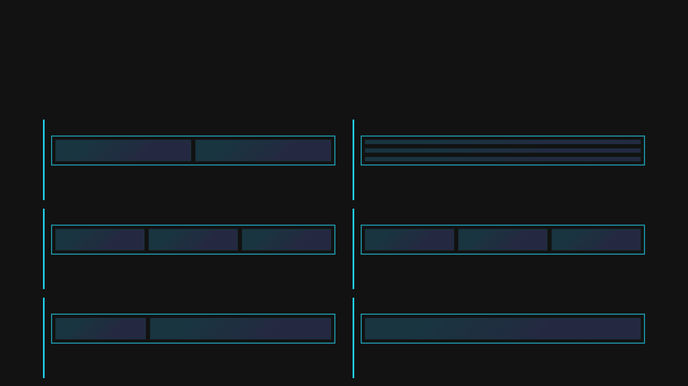
Layout Systems
Grid & Flexbox Mastery
CSS Grid
Flexbox
2-Column Grid
Vertical List
grid-template-columns: 1fr 1fr;
flex-direction: column; gap: 12px;
Equal-width columns for balanced layouts
Sequential items stacked vertically
3-Column Grid
Horizontal List
grid-template-columns: 1fr 1fr 1fr;
flex-direction: row; gap: 12px;
Three parallel concepts with equal emphasis
Items arranged horizontally with equal spacing
Asymmetric Grid
Centred Flex
grid-template-columns: 1fr 2fr;
justify-content: center; align-items: center;
Unequal columns for visual interest
Centred content with flexible spacing
Notes:
Grid and Flexbox are the workhorses of modern web and presentation design. They are not interchangeable; they solve different problems. CSS Grid is for two-dimensional layouts, managing both rows and columns simultaneously. It's perfect for creating those structured layouts we discussed earlier, like the 2-Column, 3-Column, or the Asymmetric Grid. Notice how we use the fractional unit, 1fr, to ensure the columns adapt perfectly to the available space. Flexbox, on the other hand, is for one-dimensional layouts, managing items either in a row or a column. We use it extensively for things like the Vertical List, where we stack items and control the gap between them, or for Centred Flex, which is the easiest way to perfectly align content both horizontally and vertically. Understanding when to use Grid versus Flexbox is the key to efficient and responsive design. We use these tools to structure our content, but sometimes we need a little extra flair, which is where gradients come in.

Slide 10

Visual Enhancement
Gradients for Visual Interest
Linear Gradients
Horizontal (90deg), vertical (180deg), or diagonal (135deg) colour transitions
background: linear-gradient(90deg, #22D3EE 0%, #8B5CF6 100%)
Multi-stop Gradients
Three or more colours for complex, sophisticated effects
background: linear-gradient(90deg, #22D3EE 0%, #8B5CF6 50%, #EC4899 100%)
Gradient Text
Apply gradients directly to text using background-clip property
background-clip: text; -webkit-text-fill-color: transparent
Gradient Text
Gradient Borders
Create accent lines and borders with gradient effects
border-image: linear-gradient(180deg, #22D3EE 0%, #8B5CF6 100%)
Gradient Border
Application
Use gradients on numbered markers, accent lines, and background elements to add depth and visual interest without images
Notes:
Gradients are a fantastic way to add depth and visual interest without resorting to complex imagery. They provide a modern, sophisticated feel when used correctly. We primarily use Linear Gradients, which transition smoothly between two or more colours along a straight line, whether that's horizontal, vertical, or diagonal. For more complex effects, we use Multi-stop Gradients, which allow us to define specific points where the colour changes, creating a richer blend. But the real power comes in their application. We can apply gradients directly to text using the background-clip property, making key titles pop. We also use Gradient Borders to create subtle accent lines and frames. The key takeaway here is that gradients are a non-image-based way to add texture and dimension. They are lightweight and highly scalable, perfect for adding that final polish. Next, we'll explore how to use pseudo-elements to further enhance our designs with subtle decorative touches.

Slide 11
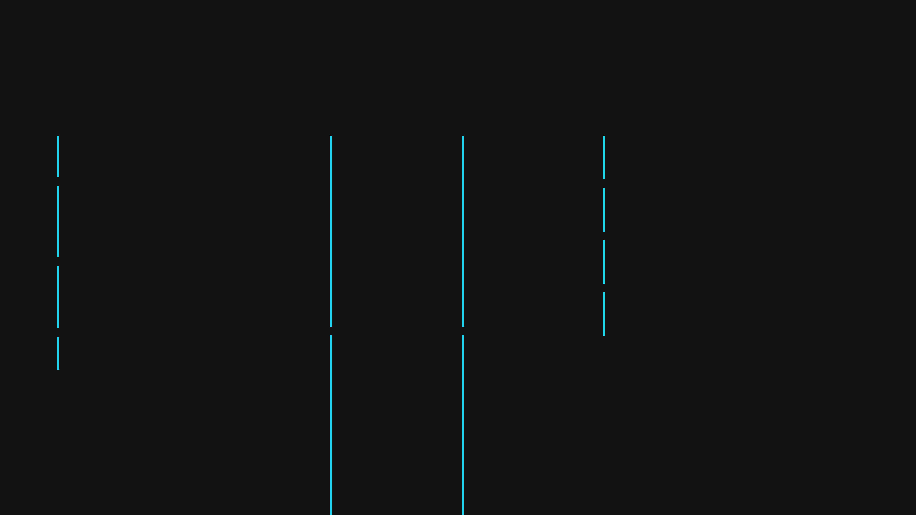
HTML Optimisation
Pseudo-Elements for Decoration
Accent Line
Accent Line
Bullet Point
Accent Lines
Visual separator with ::before
element::before {\n content: '';\n width: 40px;\n height: 3px;\n background: gradient;\n}
element::before {\n content: '';\n width: 8px;\n height: 8px;\n background: #22D3EE;\n border-radius: 50%;\n}
Use ::before to create visual separators and accent lines without extra HTML elements
Bullet Points
Bullet Points
Custom bullet one
Create custom bullets without list markup. Cleaner HTML, easier to style consistently
Custom bullet two
Custom bullet three
Section Numbers
Section Number
Add large faded background numbers using ::after. Enhances visual hierarchy without cluttering
03
Benefits
Large faded number with ::after
Cleaner HTML structure, easier maintenance, faster to build, reduces file size, professional results
Visual Indicator
Section Number
Visual Indicator
Gradient indicator with ::before
element::after {\n content: '03';\n font-size: 48px;\n opacity: 0.1;\n position: absolute;\n}
element::before {\n content: '';\n width: 12px;\n height: 12px;\n background: gradient;\n}
Notes:
We've looked at using gradients for visual interest, but how do we add small, functional decorative elements without cluttering our HTML? Pseudo-elements are the answer. They allow us to inject purely decorative content using only CSS, keeping our markup clean and semantic. For instance, you can use the ::before pseudo-element to create a small accent line or a custom bullet point for a list. This is fantastic for maintaining a clean HTML structure. You're not adding extra div tags just for a tiny visual flourish. You can also use ::after to add large, faded section numbers in the background, which enhances the visual hierarchy without distracting the reader. The key benefit here is maintainability; all your decorative elements are controlled in one place, making it faster to build and easier to update. This approach gives us professional results with a much lighter code footprint. Now that we've covered the visual decoration, let's talk about the content itself and how we structure it for maximum impact.

Slide 12
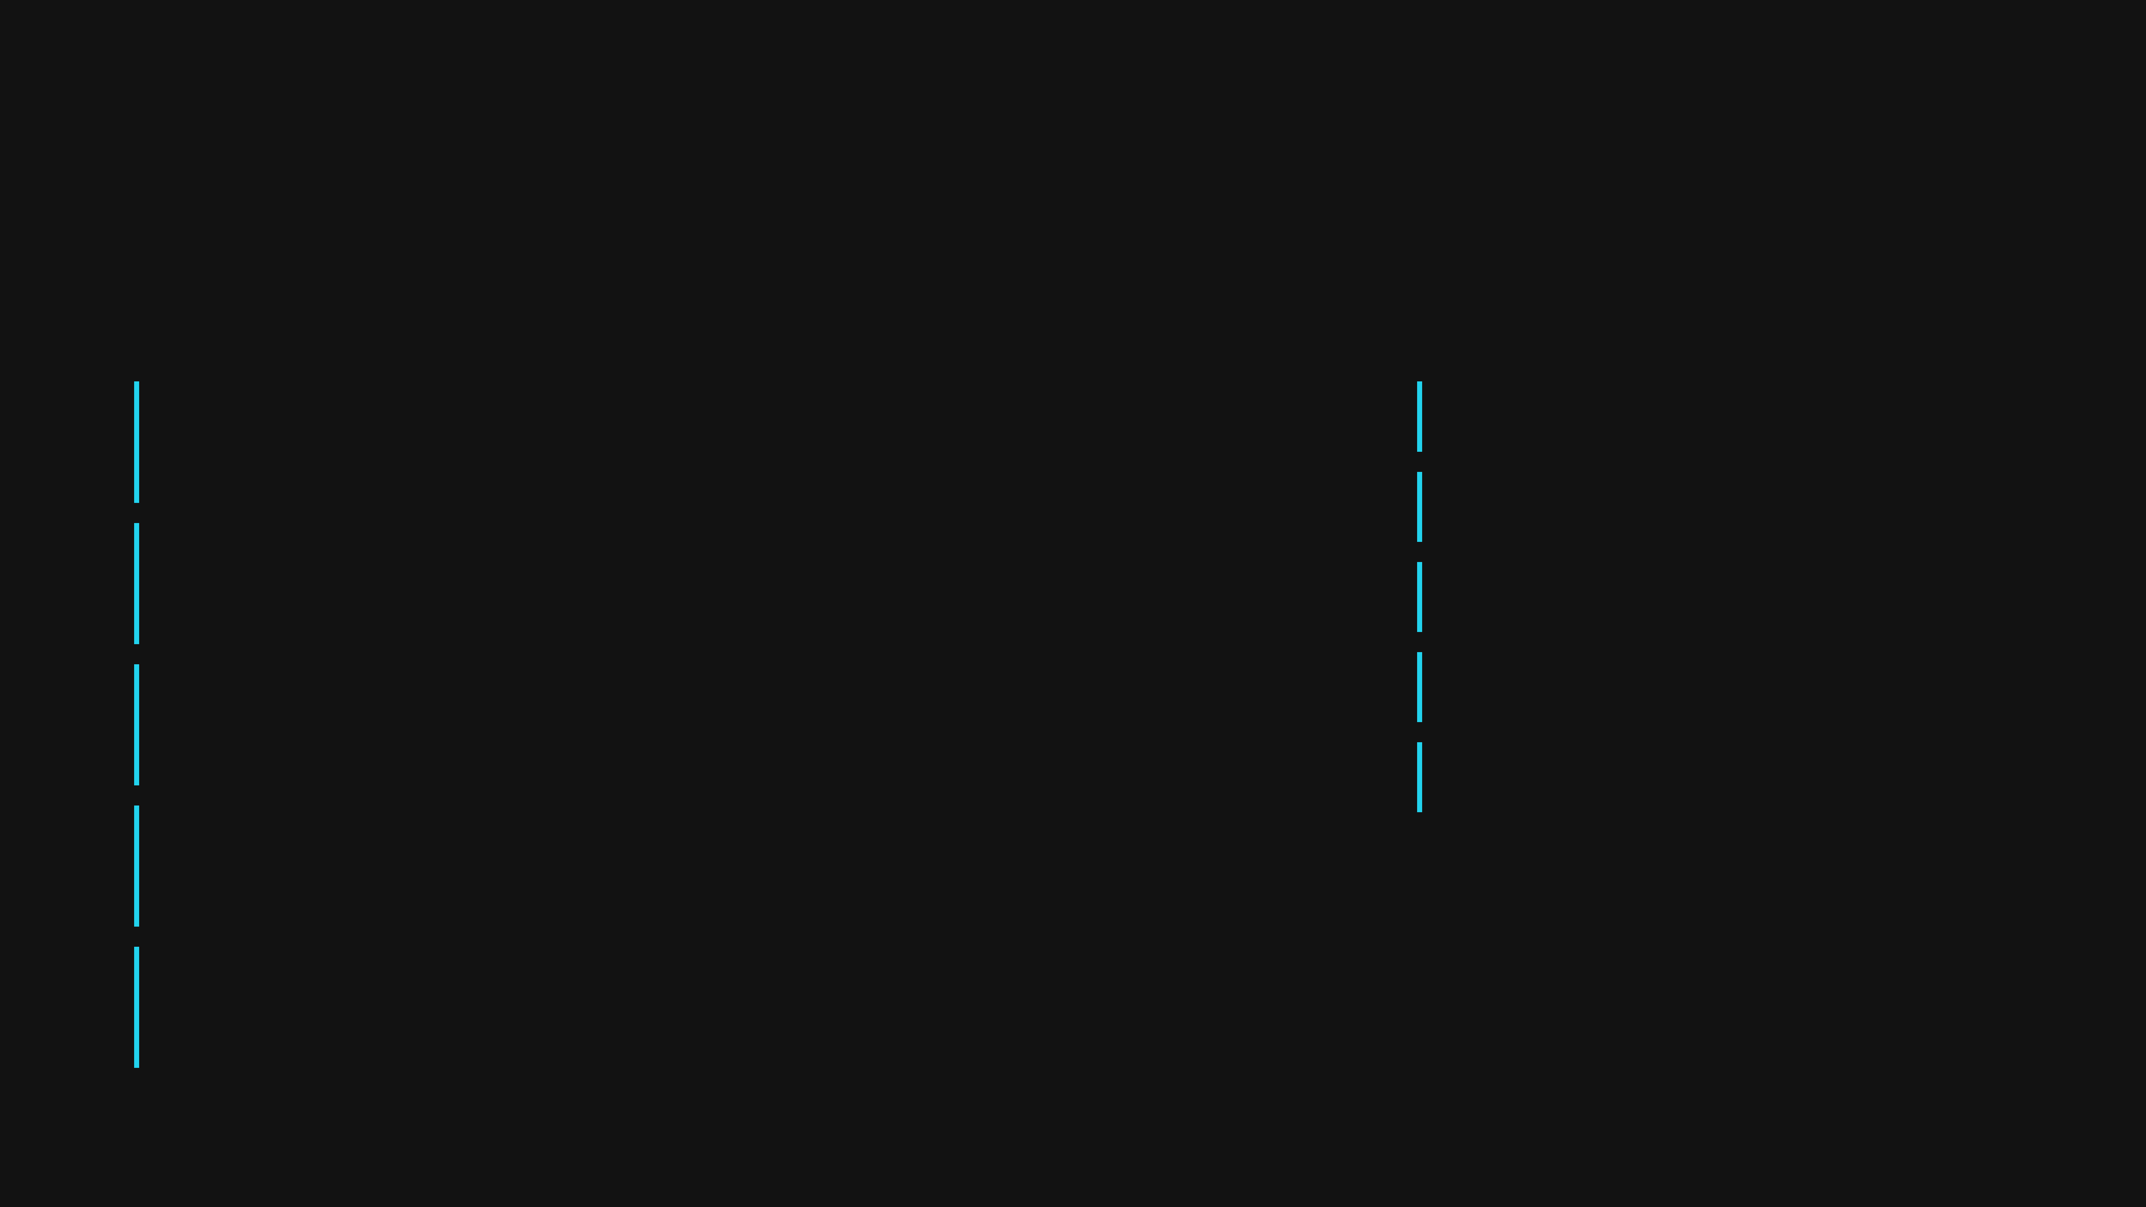
Content Strategy
Content Architecture & Text Density
Guidelines
Examples
Principles
Slide Titles
Slide Title
Scanability
3–5
Viewers should grasp content in 3 seconds maximum.
words maximum
Subtitle
Visual Weight
This is body text demonstrating recommended density. Keep it scannable and concise.
Every word must earn its place on the slide.
Subtitles
1–2
First key point
Hierarchy
words maximum
Second key point
Use size, weight, and spacing to guide attention.
Body Text
Third key point
Whitespace
15–25
Generous spacing makes content feel less overwhelming.
words per paragraph
Impact
Bullet Points
Less text = greater impact and memorability.
3–5
per section
Labels
1–3
words maximum
Notes:
Once the visual design is sorted, we must turn our attention to the content architecture, because even the most beautiful slide fails if the text is too dense. The goal here is scanability; viewers should be able to grasp the core message in about three seconds. We achieve this by strictly limiting the text density. Notice the guidelines: keep your slide titles to three to five words maximum, and body text should be concise, ideally fifteen to twenty-five words per paragraph. Every word must earn its place on the slide; if it doesn't add value, remove it. We also need to use visual weight and hierarchy effectively. Use size, weight, and spacing to guide the viewer's eye to the most important information first. Generous use of whitespace is crucial here; it makes the content feel less overwhelming and actually increases comprehension. Ultimately, less text equals greater impact and memorability, which is exactly what we want from our educational materials. But even with these guidelines, it's easy to fall into common traps, so let's look at how to avoid them.

Slide 13
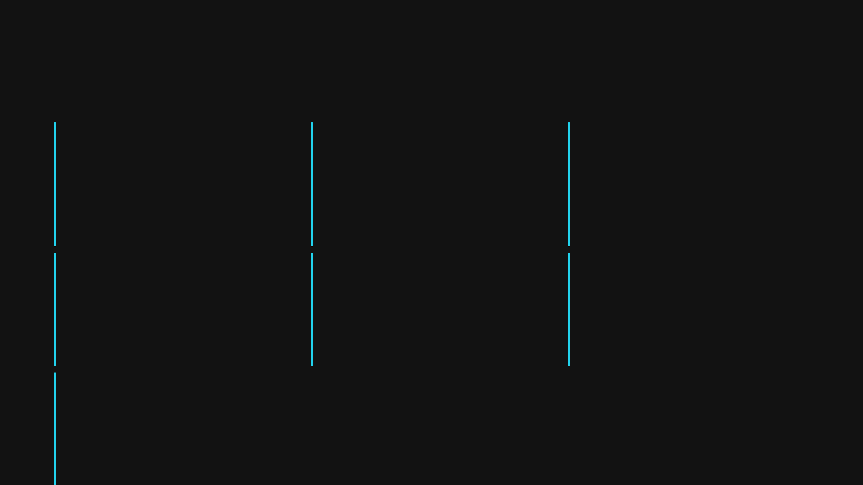
Quality Assurance
Common Pitfalls & Solutions
Pitfall 1
Pitfall 2
Pitfall 3
Inconsistent Spacing
Too Many Colours
Mismatched Typography
Random spacing values create visual chaos and an unprofessional appearance
Using more than three colours dilutes brand identity
Multiple fonts or inconsistent sizes create visual disorder
✓ Stick to 3 colours: primary, secondary, accent
✓ Use a consistent spacing scale: 8px, 12px, 16px, 24px, 32px
✓ Use a consistent type scale and one font family
Pitfall 4
Pitfall 5
Pitfall 6
Poor Contrast
Overflow Content
Inconsistent Alignment
Low contrast makes content unreadable
Excess content or large padding can push slides beyond 720px
Elements without a grid or consistent layout cause misalignment
✓ Maintain WCAG AA contrast for legibility
✓ Reduce gaps and padding; simplify content
✓ Use CSS Grid or Flexbox consistently
Pitfall 7
Unclear Visual Hierarchy
All text appearing equal makes it unclear where to look first
✓ Use size, weight, and spacing for clear hierarchy
Notes:
We've established the principles of good design, but execution often reveals common pitfalls that undermine the final result. One of the most frequent issues is inconsistent spacing, where random pixel values create visual chaos. The solution is simple: adopt a consistent spacing scale, perhaps based on multiples of four or eight pixels, and stick to it religiously. Another common trap is poor contrast, which makes your content unreadable, especially for those with visual impairments. Always maintain WCAG AA contrast standards for legibility. Finally, watch out for unclear visual hierarchy. If all your text looks the same, the viewer doesn't know where to look first. Use size, weight, and spacing deliberately to create a clear path through the content. By addressing these pitfalls—inconsistent spacing, too many colours, poor contrast, and unclear hierarchy—you ensure the quality and professionalism of your final output.

